Slide 1
CSC1004 Tutorial 2 Zhihan Ning

Slide 2
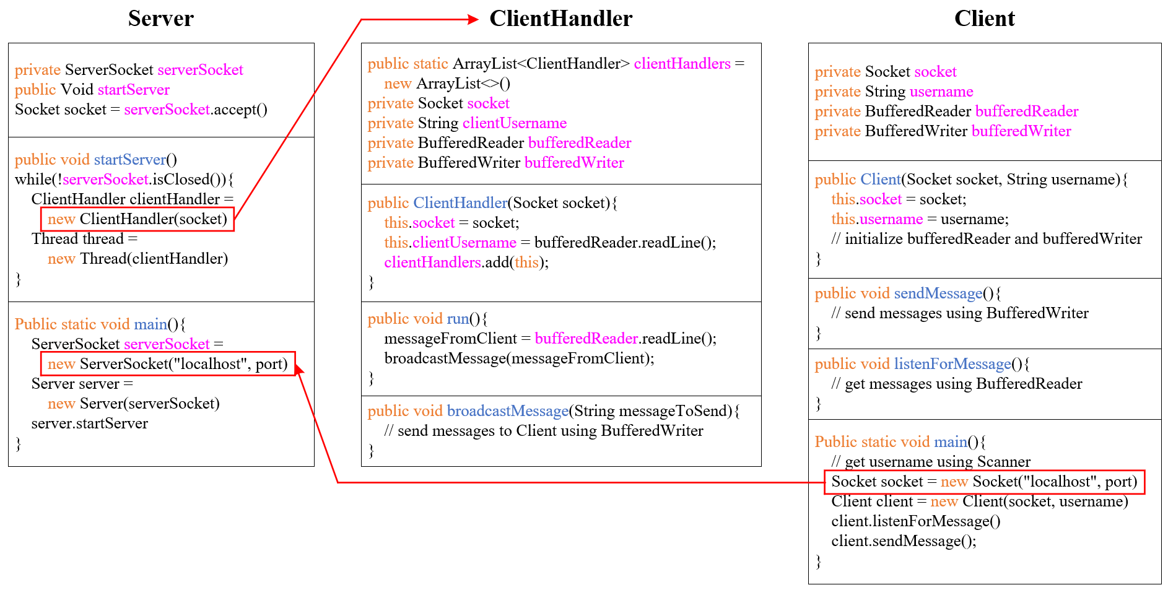
Framework of Project #1

Slide 3
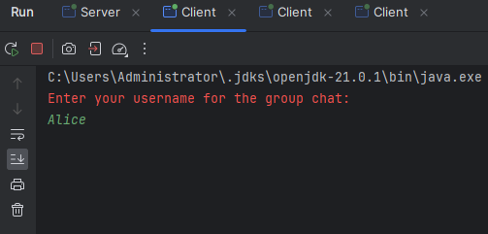
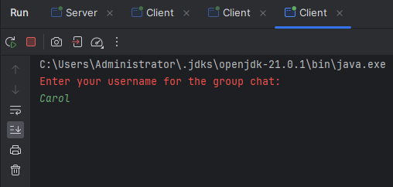
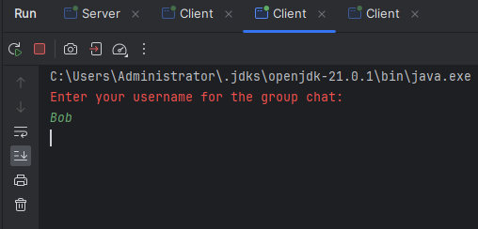
Sample Output
First, run the server.
Then input Alice, Bob, and Carol to three clients, respectively.

Slide 4
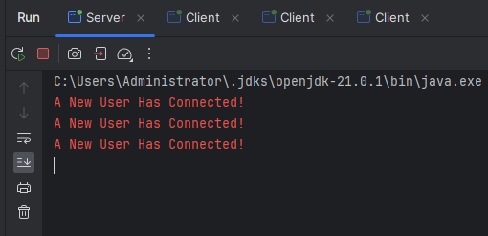
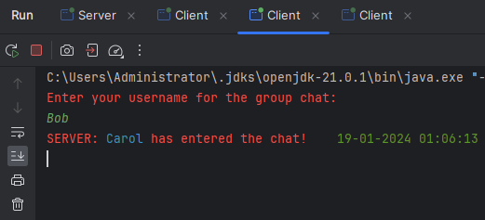
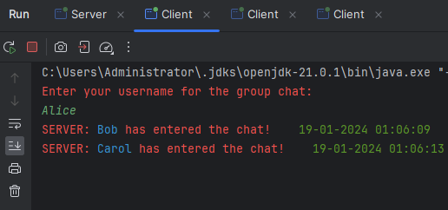
Sample Output
Upper-left: outputs of the server.
Lower-left and upper-right: outputs of the clients.

Slide 5
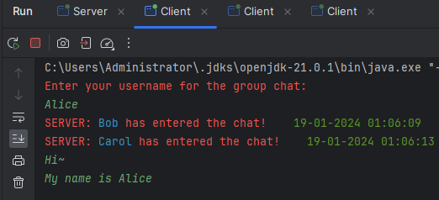
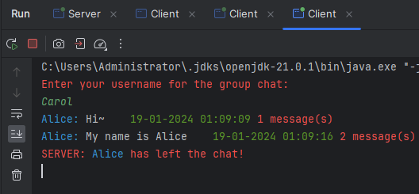
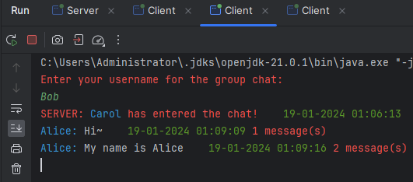
Sample Output
Upper-left: Alice sends messages.
Lower-left: Bob receives messages from Alice.
Upper-right: Carol’s view when Alice logs out.

Slide 6

THANK YOU
林天麟 教授
香港中文大学（深圳）
机器人与人工智能实验室
WeChat: tinlunlam

